Slide 1
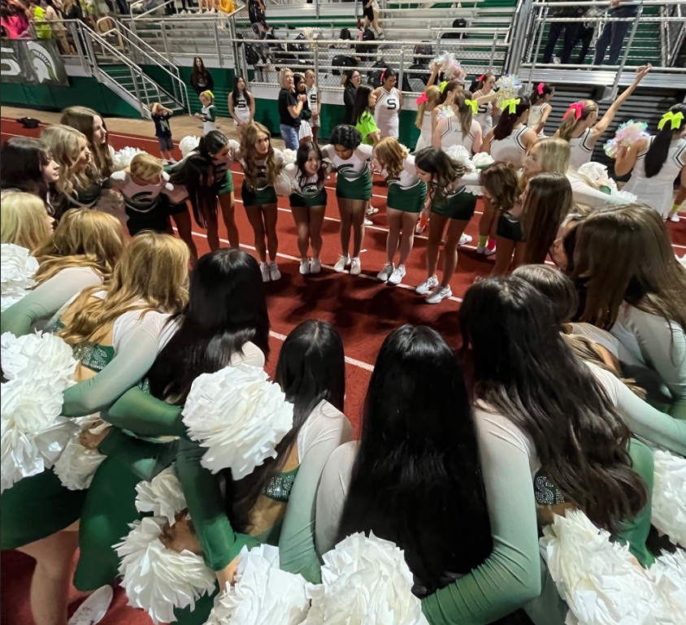
End-to-end Inspectable Topology Optimization in Julia via Adjoint Method
May 6, 2026
Presented by Rena Wang
MIT MechE
Fun fact: I’ve done ~7 different types of dance

Slide 2
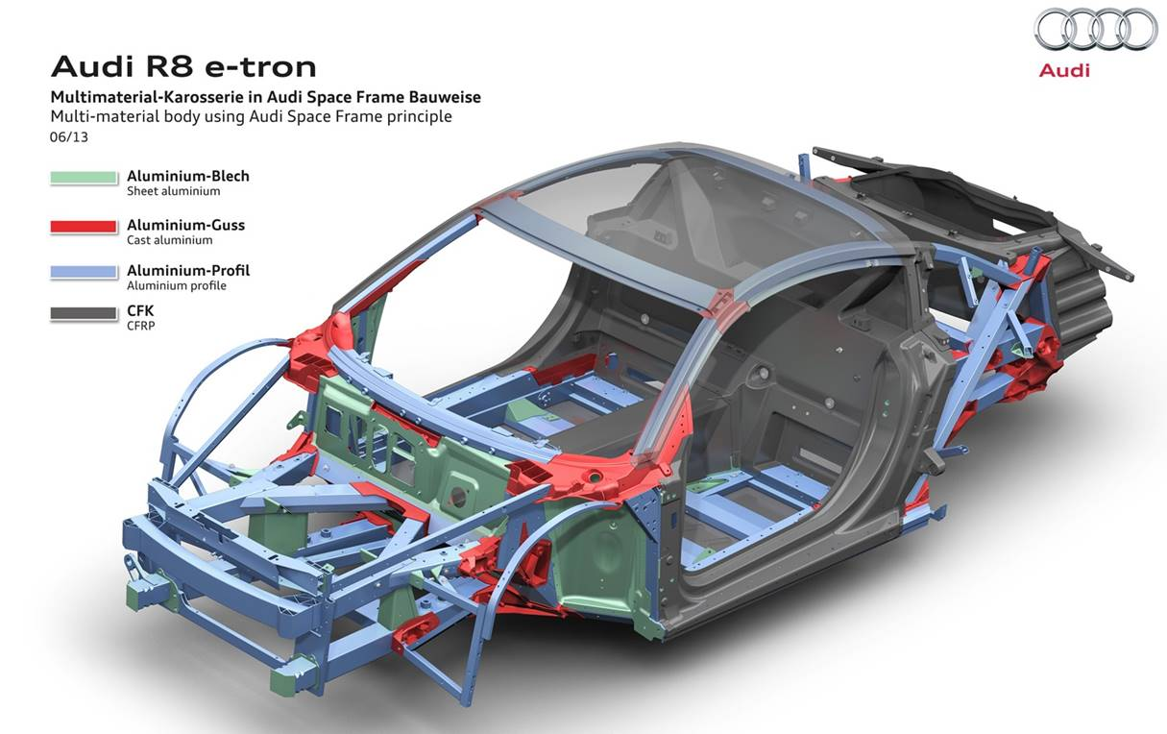
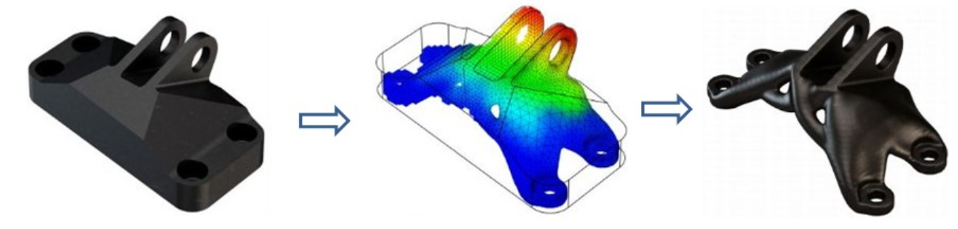
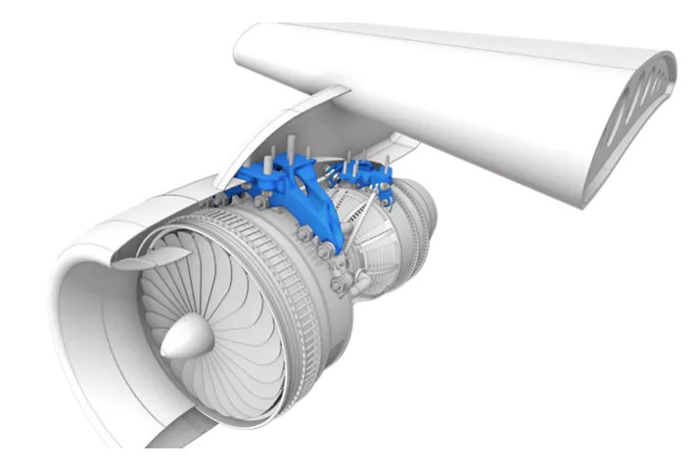
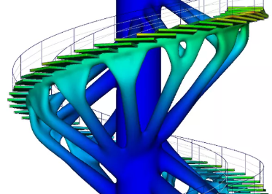
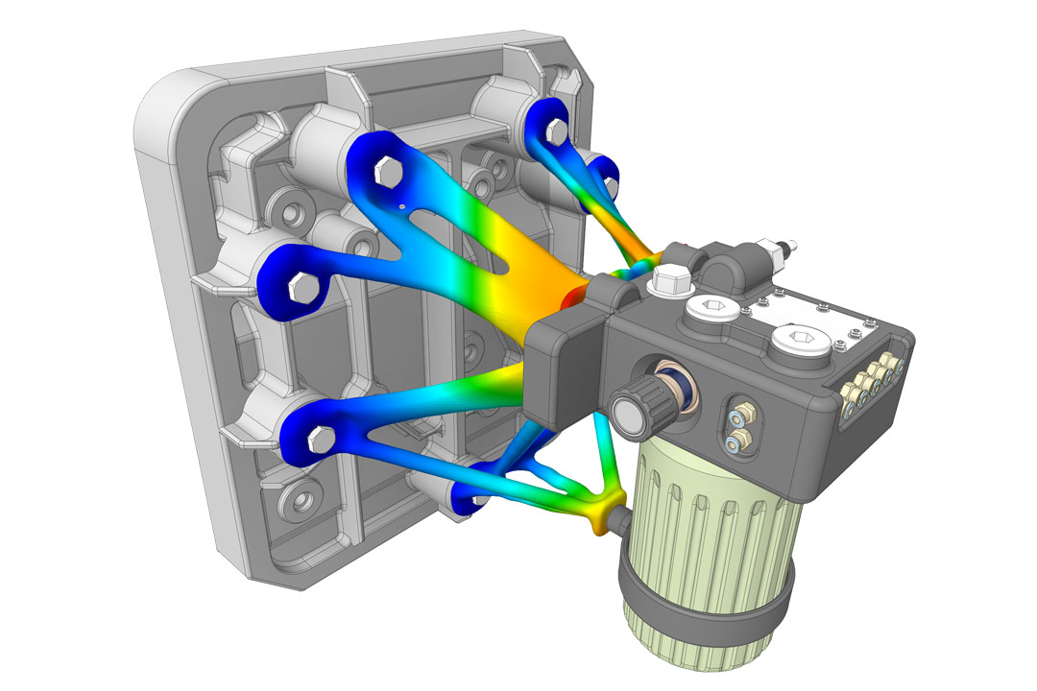
Topology Optimization - Intro
May 6, 2026
MIT 18.337/6.7320
2
Given a design space and constraints where should material go so the structure performs best?
[1]
[2]
[3]
[1] Siemens Parasolid v32.0 Release Highlights [2] Novatr Topology Optimization guide [3] Ansys

Slide 3
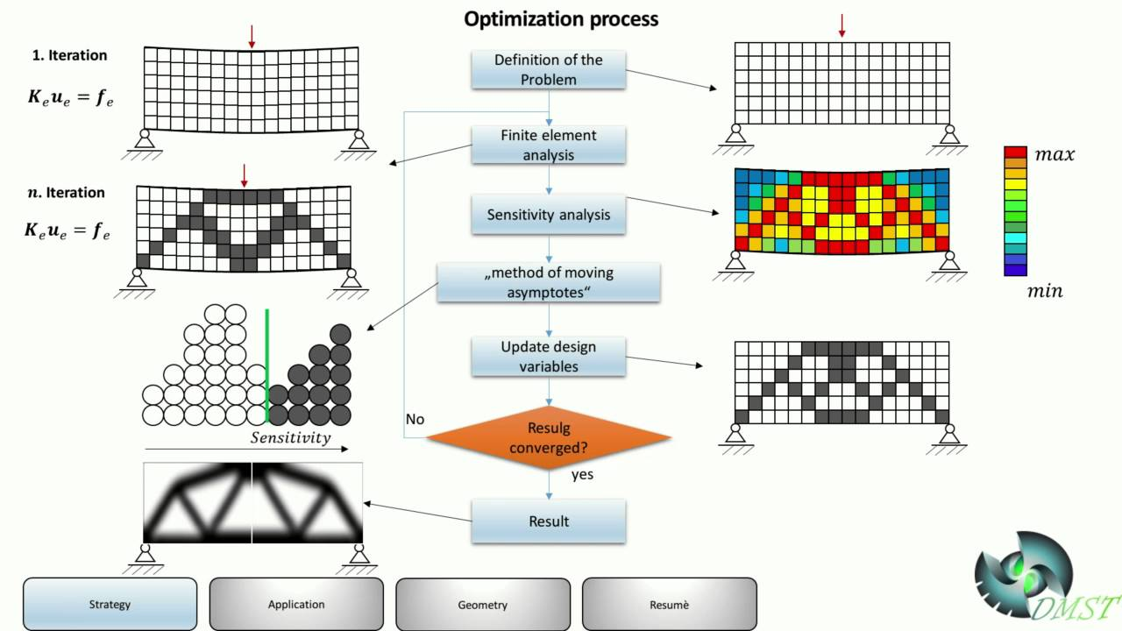
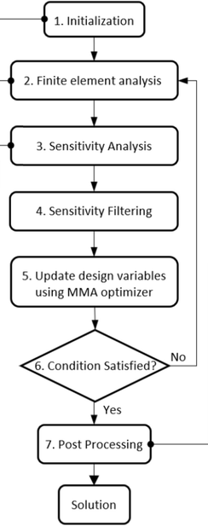
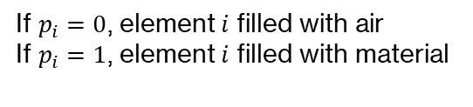
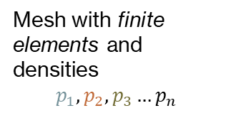
Finite Element Method (FEM)
May 6, 2026
MIT 18.337/6.7320
3
Mesh with finite elements and densities
$$p_{1}, p_{2}, p_{3}…p_{n}$$
MMA Algorithm
Updated Design
If $p_{i}=0$, element $i$ filled with air
If $p_{i}=1$, element $i$ filled with material
Figure adapted from Banh et al. (2023)

Slide 4
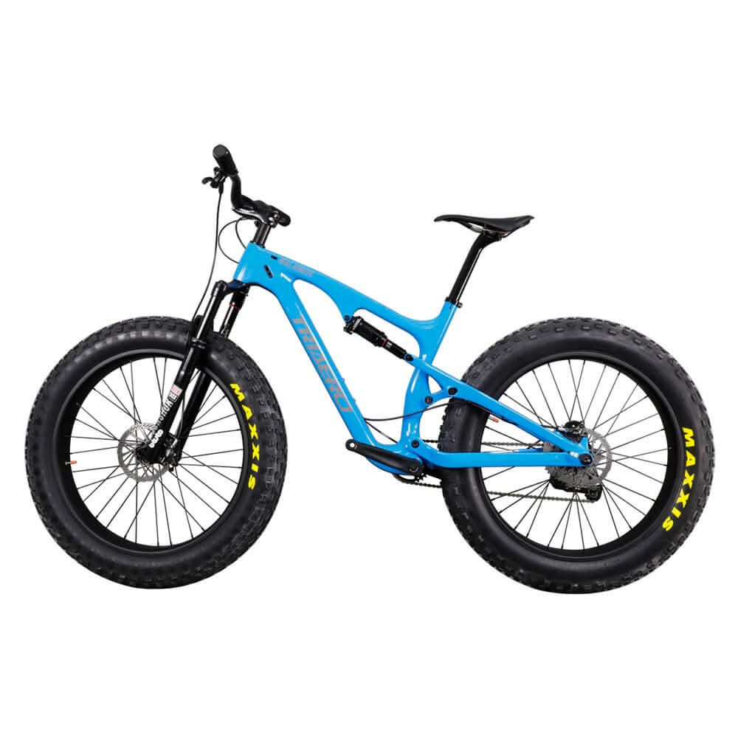


Motivation
May 6, 2026
MIT 18.337/6.7320
4
Very large number of parameters $p_{i}$
Forward solve of system PDEs
Black Box in commercial topology optimizers
Very few end-to-end open-source topology optimizers
Julia libraries like TopOpt.jl limited to a few pre-defined meshes
For an objective function $J$, compute gradients $\frac{δJ}{δp_{i}}$
?
Gradient-based optimizer
Design file to be fabricated
Figure adapted from Banh et al. (2023)

Slide 5
Motivation
May 6, 2026
MIT 18.337/6.7320
5
A modular Julia algorithm lets us inspect and modify each algorithmic component
Add custom constraints for manufacturing, multiphysics etc.
Search for optimal hyperparameters
Work with more complex objectives
Leverage Julia’s JIT computation, AD libraries etc. to balance runtime and keep code intuitive
Very large number of parameters $p_{i}$
Forward solve of system PDEs
For an objective function $J$, compute gradients $\frac{δJ}{δp_{i}}$
Gradient-based optimizer
Design file to be fabricated
Figure adapted from Banh et al. (2023)

Slide 6
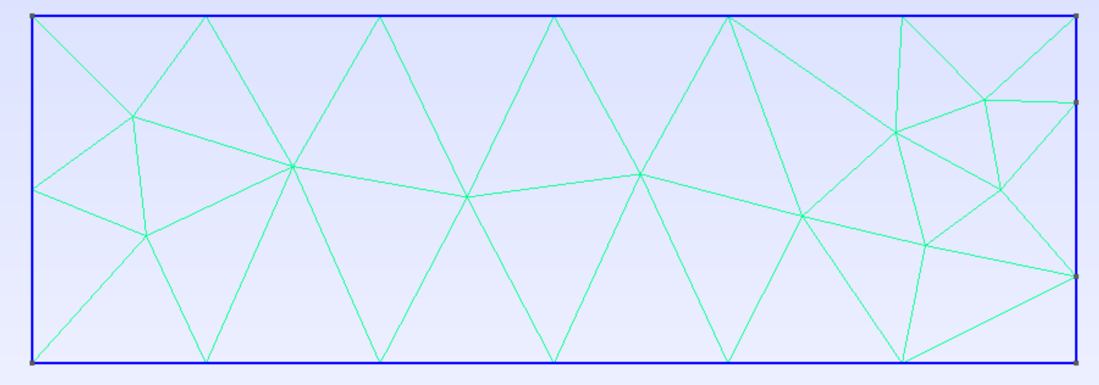
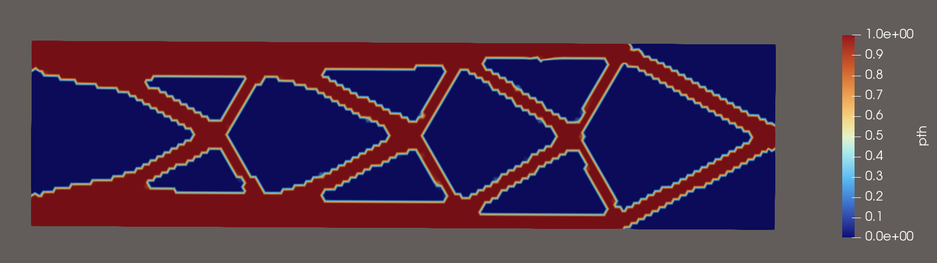






Proposed General Algorithm
May 6, 2026
MIT 18.337/6.7320
6
Gmsh.jl
Define design area and constraints
Gridap.jl
Identify FEM params and define integration
Initialize with uniform material distribution
Helmholtz filter
Smooth design via minimum length scale
$$Ω, Ω_{d}, Γ_{\left\{load\right\}}$$
$$p_{0}$$
Mesh file
etc.
$$p_{f}$$
Zygote.jl
Compute adjoint sensitivities
Forward solve and define objective function
Assemble physical system equations
Threshold Projection
Push intermediate values to density of 0 or 1
$$g, u_{h}$$
$$p_{th}$$
$$\frac{dg}{dp_{0}}$$
NO
Final Design
NLOpt.jl
Method of Moving Asymptotes (MMA) optimization
Convergence criteria met?
YES

Slide 7
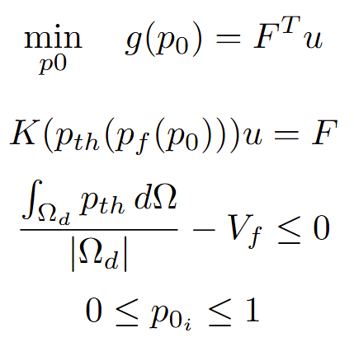
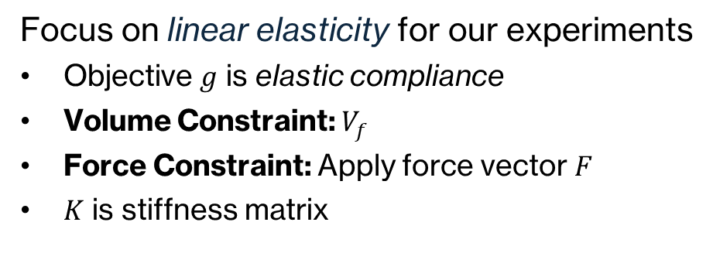
Optimization Problem
May 6, 2026
MIT 18.337/6.7320
7
Optimization Objective
Focus on linear elasticity for our experiments
Objective $g$ is elastic compliance
Volume Constraint: $V_{f}$
Force Constraint: Apply force vector $F$
$K$ is stiffness matrix

Slide 8
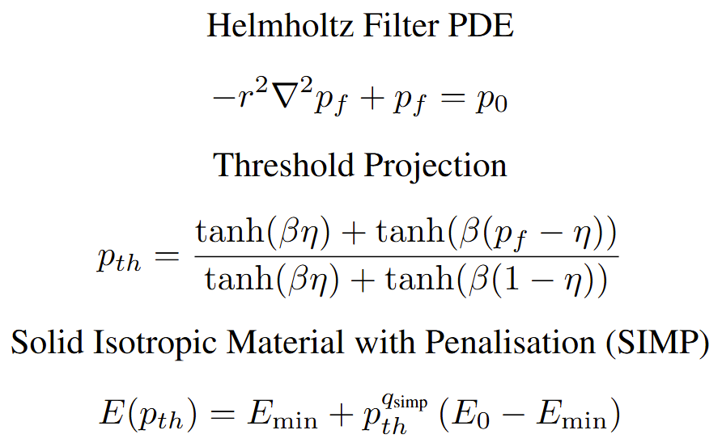
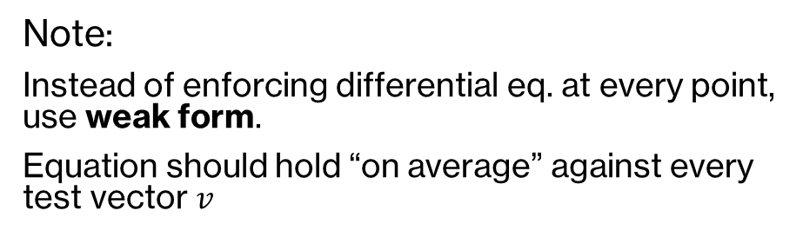
Forward Solve
May 6, 2026
MIT 18.337/6.7320
8
Note:
Instead of enforcing differential eq. at every point, use weak form.
Equation should hold “on average” against every test vector $v$
strong PDE → weak form → finite element assembly → $Ku = F$
Ex:

Slide 9
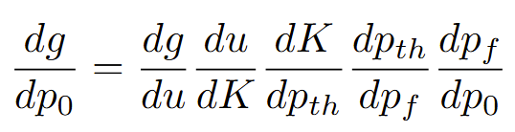
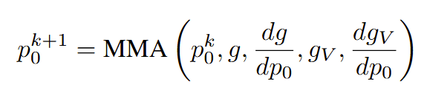
Sensitivities and Optimization
May 6, 2026
MIT 18.337/6.7320
9
Zygote.jl pulls sensitivities backwards on this chain
Use doubling $β$ scheme proposed by Sigmund (2007), performing 500 iterations with $β$ from 1 to 512

Slide 10
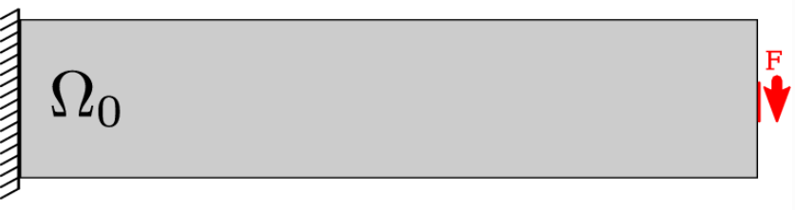
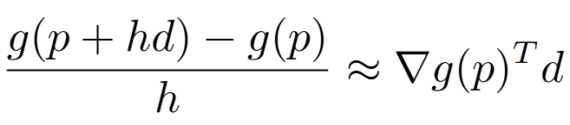

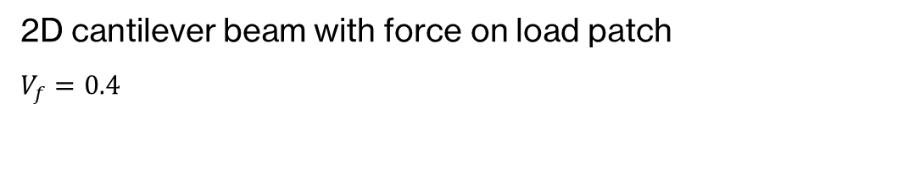
Setup & Gradient Validation
May 6, 2026
MIT 18.337/6.7320
10
2D cantilever beam with force on load patch
$V_{f}=0.4$
[1]
Validation
Directional derivative test for objective function/volume constraint
The relative error between finite-difference and adjoint gradients for multiple random $p$ and $d$ was never above 0.01.
[1] Steuben et al. (2017)

Slide 11
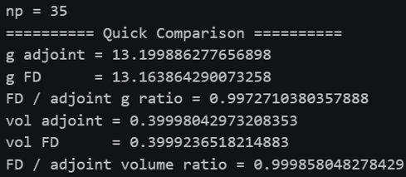
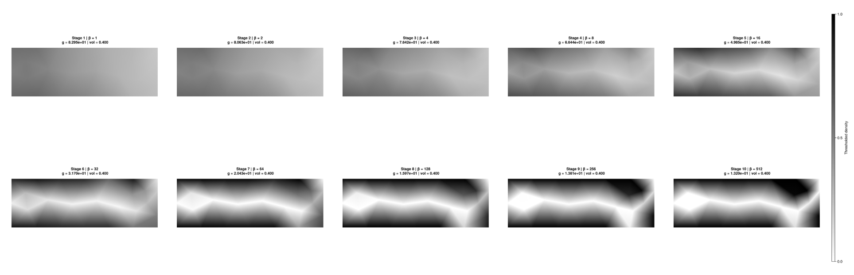
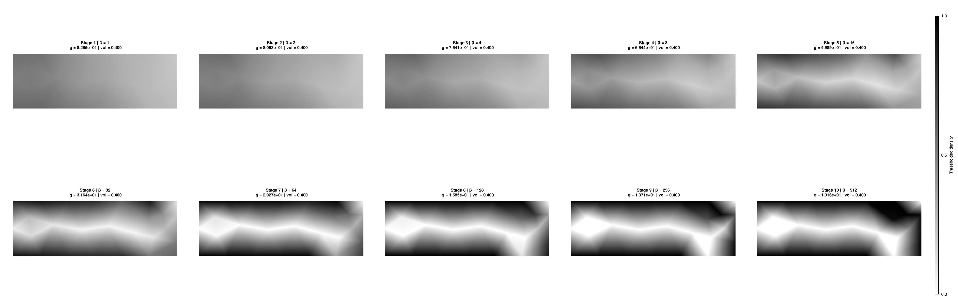
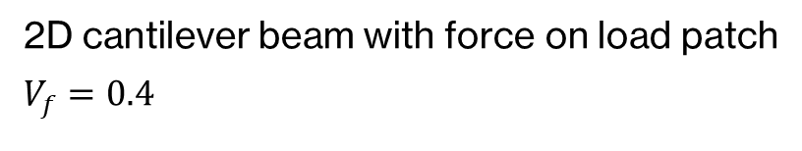
Setup & Gradient Validation
May 6, 2026
MIT 18.337/6.7320
11
2D cantilever beam with force on load patch
$V_{f}=0.4$
Adjoint MMA design progression (every 50 iters)
Validation
Full MMA optimization run with adjoint gradients vs finite-difference gradients for a case with very few parameters (np = 35)
Finite Diff. MMA design progression (every 50 iters)
[1] Steuben et al. (2017)

Slide 12
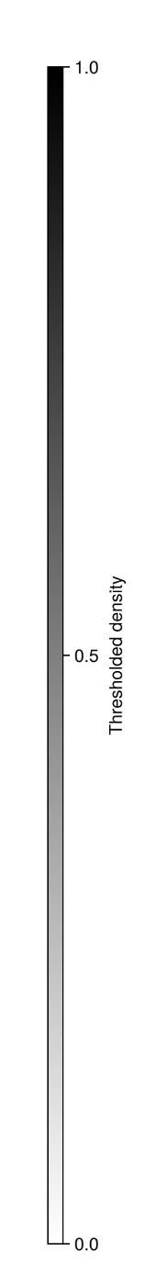


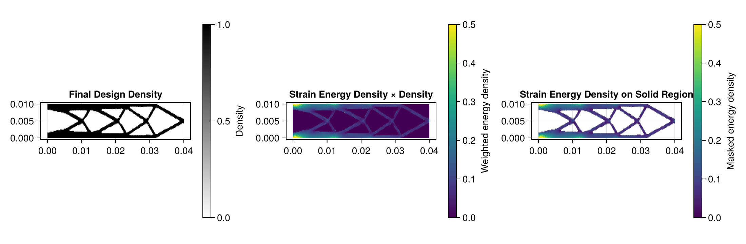
Fine Mesh Results
May 6, 2026
MIT 18.337/6.7320
12
MMA Design Progression, plotted every 50 iters | np = 14776

Slide 13
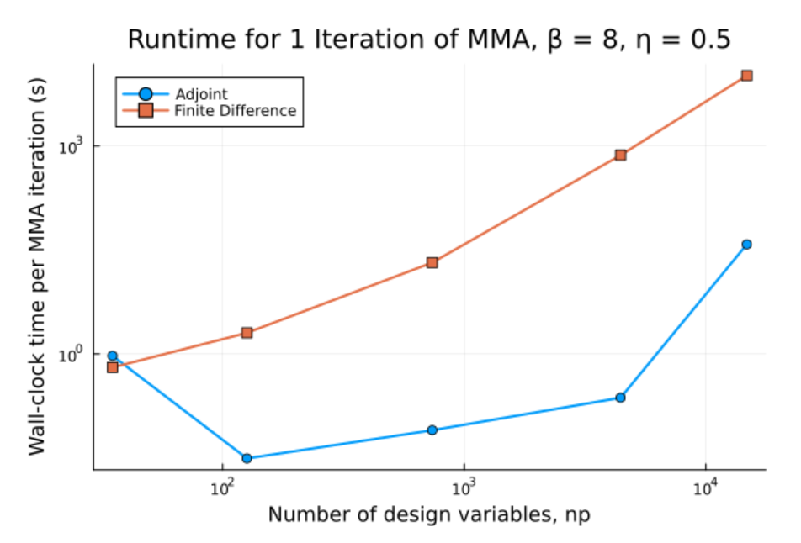
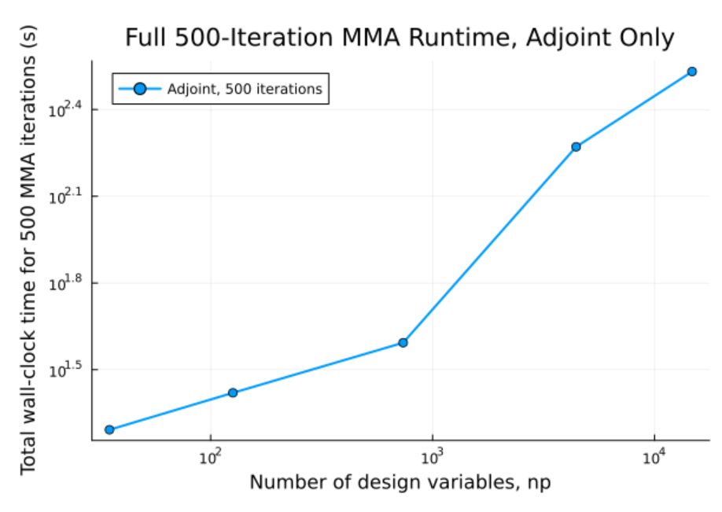
Adjoint vs Finite Difference Runtime
May 6, 2026
MIT 18.337/6.7320
13
*To save experiment time, when running finite difference only the objective function’s gradient used actual finite difference. The gradient of volume objective was calculated using adjoints, so we can expect full finite-difference runtime to be even slower

Slide 14
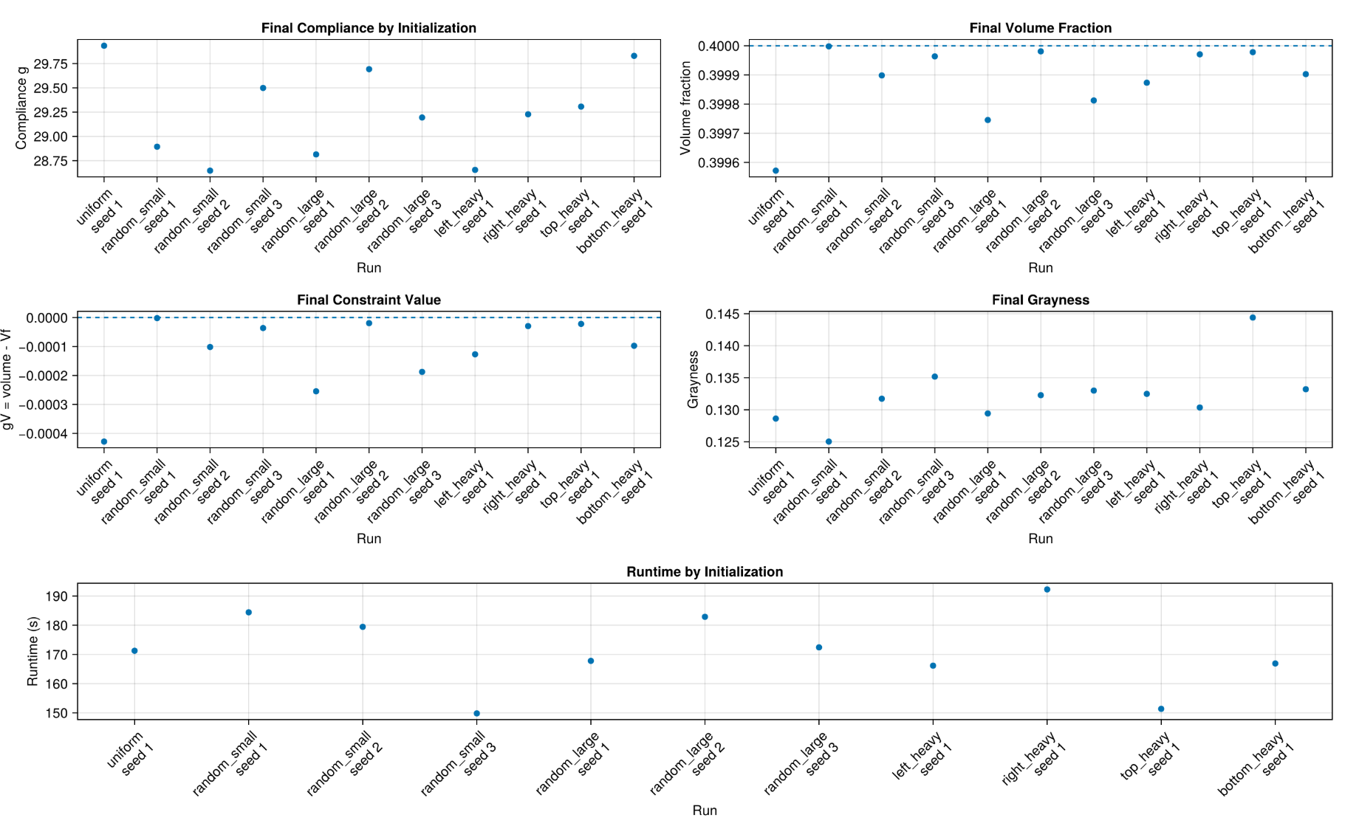
Little Sensitivity to Initialization
May 6, 2026
MIT 18.337/6.7320
14
11 different initializations
at np = 4436:
No major difference in any metric after running full MMA optimization

Slide 15
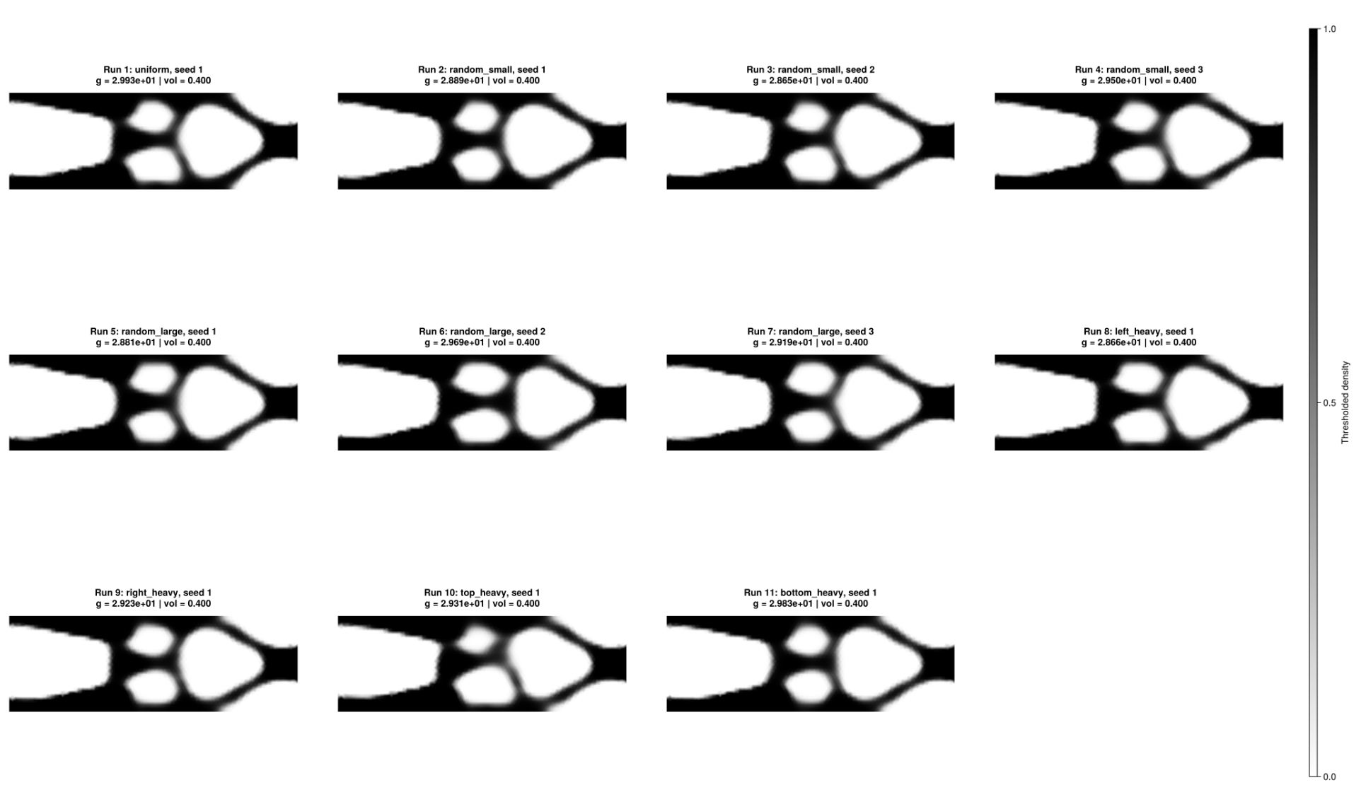
Little Sensitivity to Initialization
May 6, 2026
MIT 18.337/6.7320
15
Final designs for different initializations, np = 4436

Slide 16
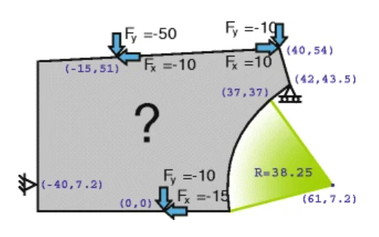
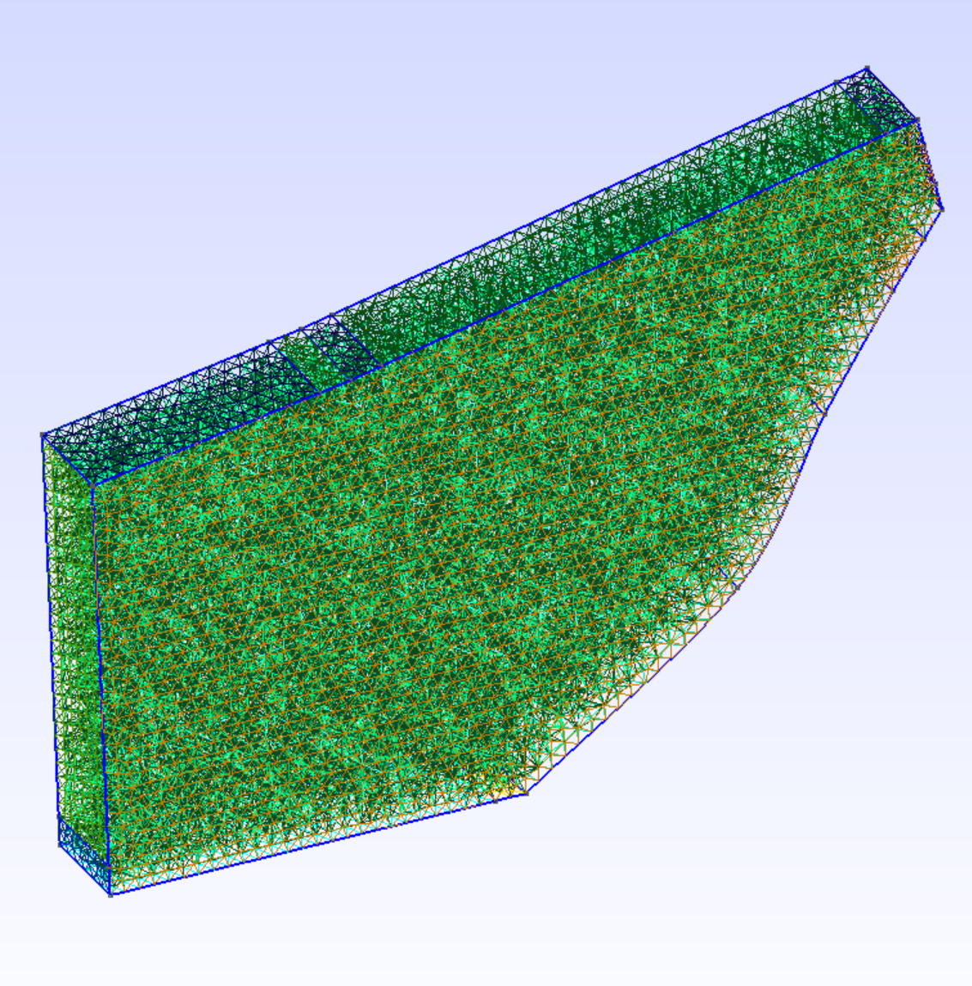
Extension to 3D
May 6, 2026
MIT 18.337/6.7320
16
Real Problem:
Bike frame design, problem modified from Zegard and Paulino (2013)
Linear elasticity
Multiple forces and constraints
3D mesh
Custom design area
seat
handlebars
np=56505
pedals
[1] Zegard and Paulino (2013)

Slide 17
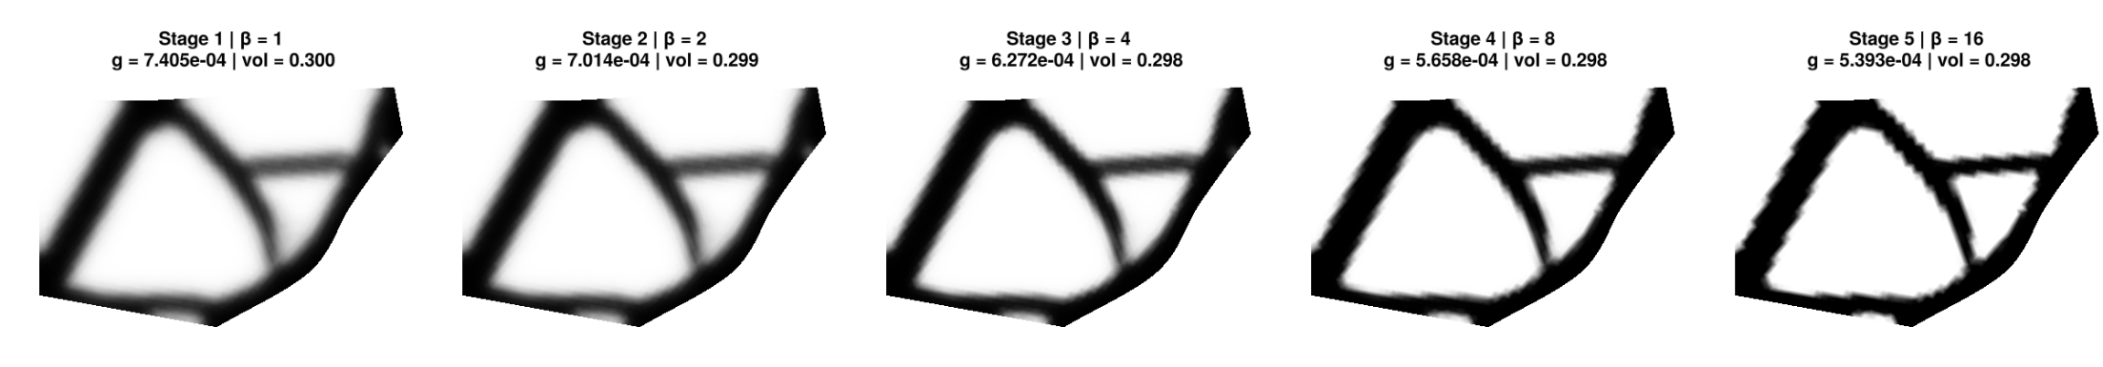

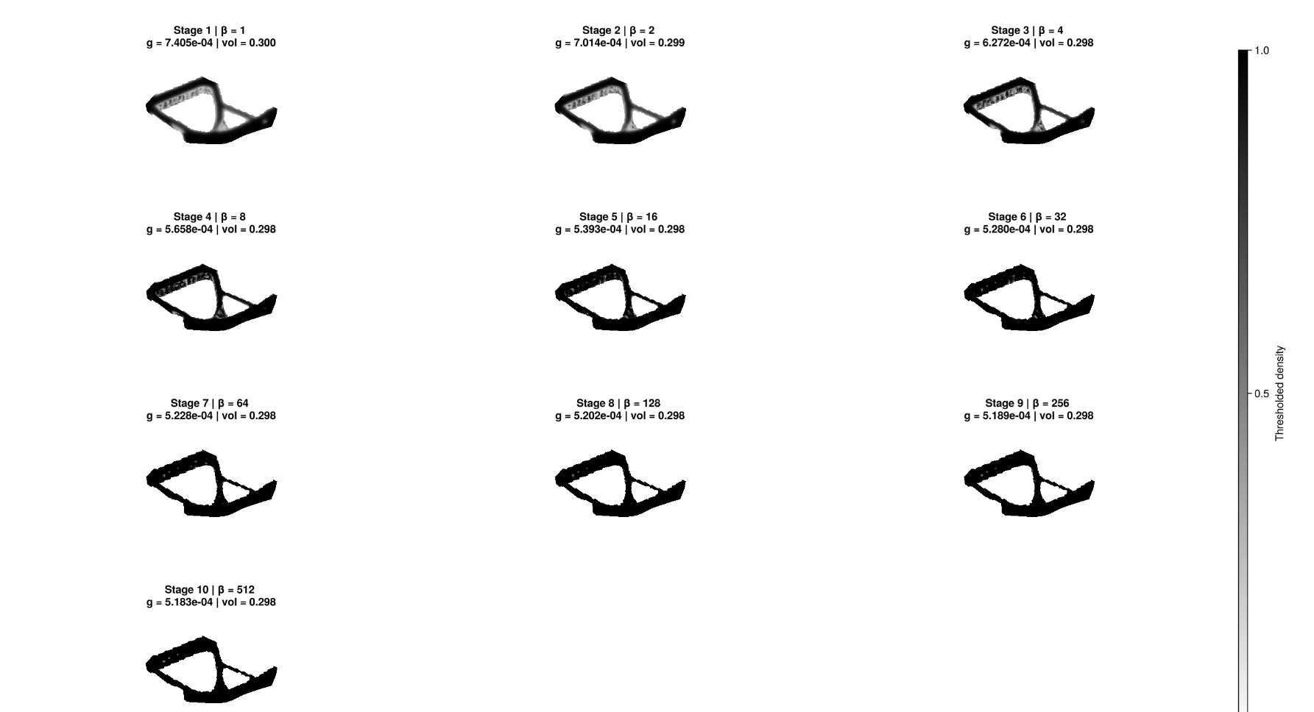
Extension to 3D
May 6, 2026
MIT 18.337/6.7320
17
Same physics and optimization parameters as 2D beam. Only problem formulation is changed in code
MMA Design Iterations, 2D Projection
MMA Design Iterations, 3D View

Slide 18
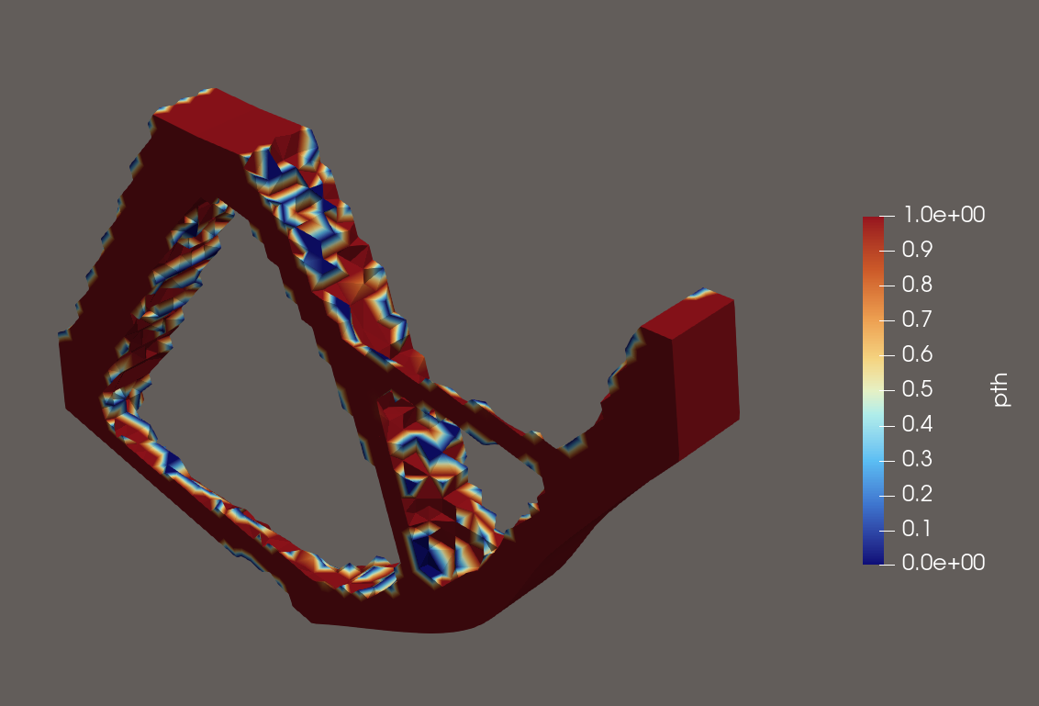
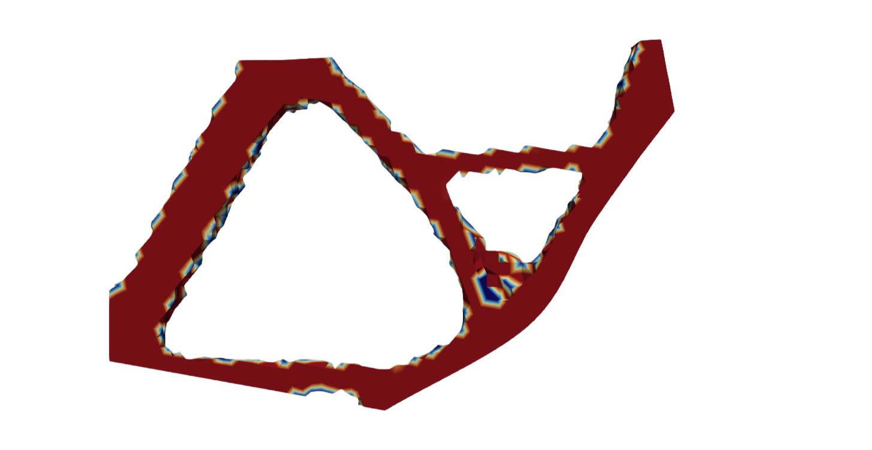
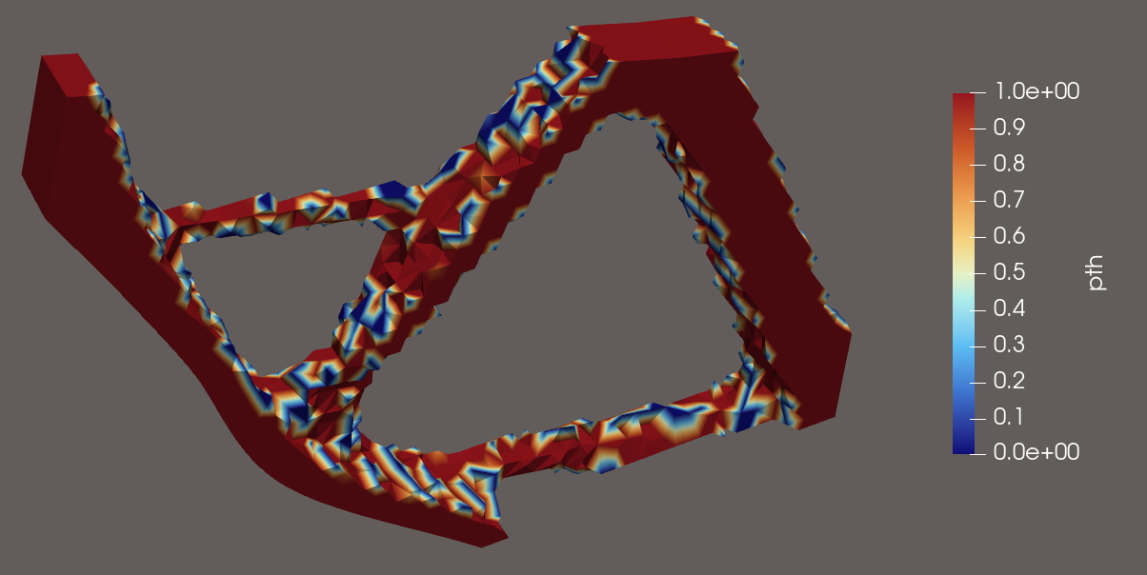
Extension to 3D
May 6, 2026
MIT 18.337/6.7320
18
Final design file to fabricate
Design Validation
[1] ICAN Bikes

Slide 19


Synthesis and Future Directions
May 6, 2026
MIT 18.337/6.7320
19
Adjoint-based topology optimization in Julia provides another level of flexibility and customization compared to industrial software, while leveraging the language to keep gradient computation scalable and the pipeline inspectable
Contributions
Fully transparent Julia Topology Optimizer
Physics module for 2D and 3D linear elasticity
Runtime benchmarking
Built-in gradient validation
Initialization sensitivity tests
Demonstration of modularity through various beam + bike tests
Limitations
Only tested linear elasticity cases
Need real-world experimental validation
Implementation only for one type of optimizer, $β$ schedule etc.
Future Directions
GPU Acceleration/HPC Parallelization
Matrix-free methods
Avoid global $K$ matrix
New physics modules (thermal, fluids…)
Manufacturing constraint implementation
Automatic hyperparameter tuning and optimization strategy choice

Slide 20
